Slide 1


Coffee Shop Sales Performance Dashboard
A deep dive into our sales data for strategic decision-making.
Notes:
1

Slide 2





Dashboard Objectives:
Analyze Performance
Identify Top Performers
Evaluate overall sales performance across all stores.
Pinpoint leading stores and peak sales days.
Track Sales Trends
Measure Against Targets
Monitor monthly sales patterns and category contributions.
Assess store sales against set targets and understand customer behavior.
Notes:
2

Slide 3

Understanding Data:
My analysis is built upon key transactional data, providing a clear picture of my operations.
Key Fields Used
Transaction Date: When purchases occurred.
Store Location: Where sales took place.
Product Category: What was sold.
Total Sales: Revenue generated per transaction.
Quantity Sold: Number of items purchased.
Target Sales: Aspirational revenue goals.
Notes:
3

Slide 4

Our Toolkit: Crafting Insights
I leverage industry-standard tools to transform raw data into actionable insights.
Tableau
Microsoft Excel
For dynamic dashboard creation and powerful data visualization.
Essential for meticulous data cleaning and preliminary organization.
MS PowerPoint
For compiling comprehensive reports and engaging presentations.
Notes:
4

Slide 5

Key Performance Indicators:
These metrics highlight the overall health and scale of coffee shop operations.
₹6.98L
149K
214K
Total Sales
Total Transactions
Total Quantity Sold
cumulative revenue.
Number of individual sales completed.
The volume of products purchased by customers.
₹3.25
Avg. Sale/Transaction
The average value of each customer purchase.
Notes:
5

Slide 6
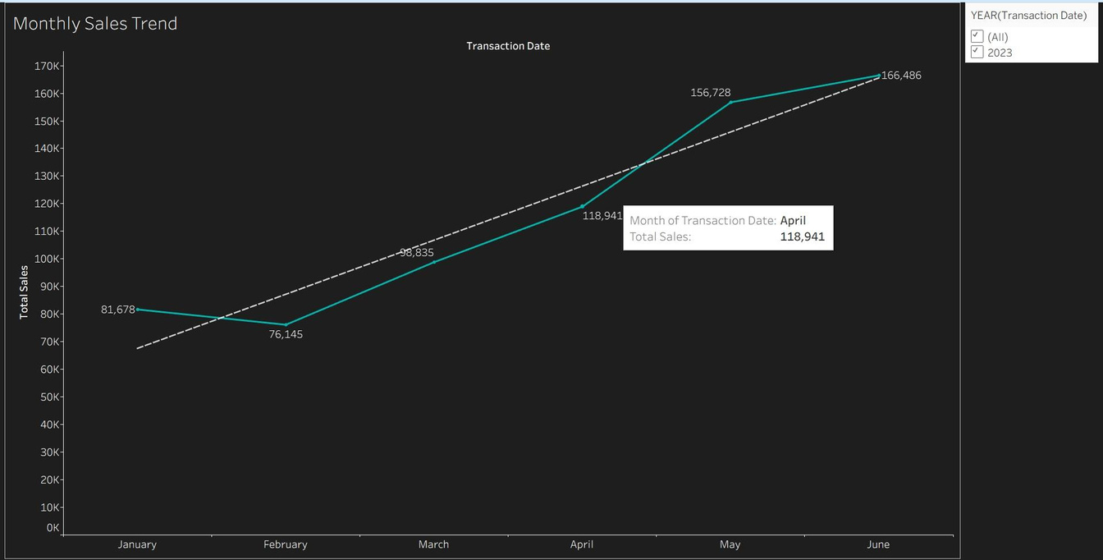
Monthly Sales Trend: A Steady Ascent
Sales data reveals a consistent and encouraging growth trajectory over the past six months.
Sales increased steadily from ₹81K in January to ₹166K in June.
This indicates a positive and healthy growth trend over the first half of the year.
June stands out as peak performance month, reflecting successful strategies or seasonal boosts.
Notes:
6

Slide 7

Store Performance: The Local Favorites
While all stores show strong performance, Hell's Kitchen leads the pack, albeit by a narrow margin.
Hell’s Kitchen
₹236,511
Astoria
₹232,244
Lower Manhattan
₹230,057
Hell’s Kitchen location is currently our best-performing store.
The sales difference between all stores is minimal, suggesting strong, consistent brand presence across locations.
This close performance indicates robust management and effective operations throughout network.
Notes:
7

Slide 8


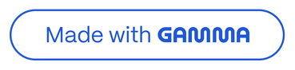
Sales vs. Target
Stores are performing well, but there's room to grow to reach our ambitious sales targets.
1
Target Sales: ₹500K
Ambitious goal for each store.
2
Hell’s Kitchen: ₹236K
Leading but still below target.
3
Astoria: ₹232K
Solid performance, nearing Hell's Kitchen.
4
Lower Manhattan: ₹230K
Consistent contribution.
While all locations demonstrate strong sales, they are currently operating below the ₹500K target, presenting an opportunity for strategic initiatives to boost revenue.
Notes:
8

Slide 9
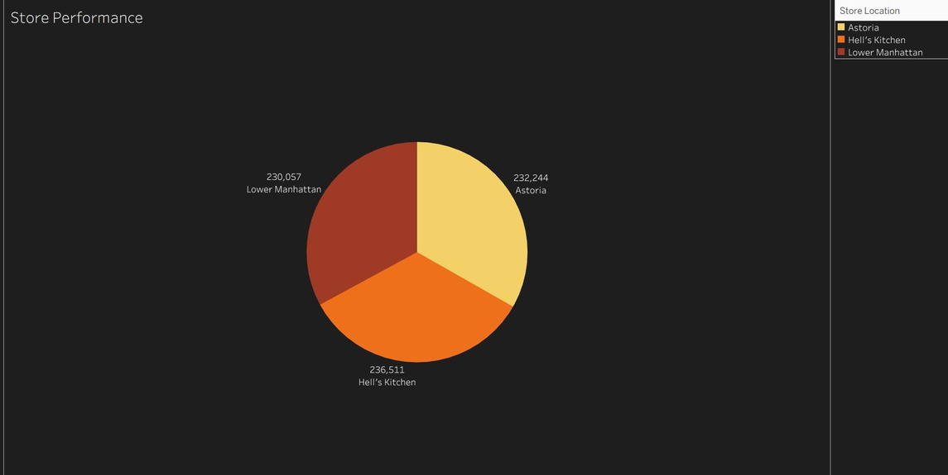
Product Category:
The core offerings, coffee and tea, are the primary drivers revenue.
Coffee and Tea categories consistently generate the maximum sales.
Bakery items and coffee beans contribute a smaller, but significant, percentage to overall sales mix.
Coffee is unequivocally top-selling category, a critical insight for inventory and marketing focus.
Notes:
9

Slide 10
Sales by Day: Weekly Peaks
Understanding daily sales patterns helps optimize staffing and promotions.
Mondays register the highest sales, indicating a strong start to the work week for customers.
Monday
101,677
Friday
100,768
Interestingly, weekdays generally outperform weekends in terms of sales volume.
Thursday
100,792
This trend suggests opportunities for targeted weekend promotions to boost footfall and revenue during those days.
Wednesday
100,725
Tuesday
99,456
Sunday
~98,000
Saturday
~97,000
Notes:
10

Slide 11
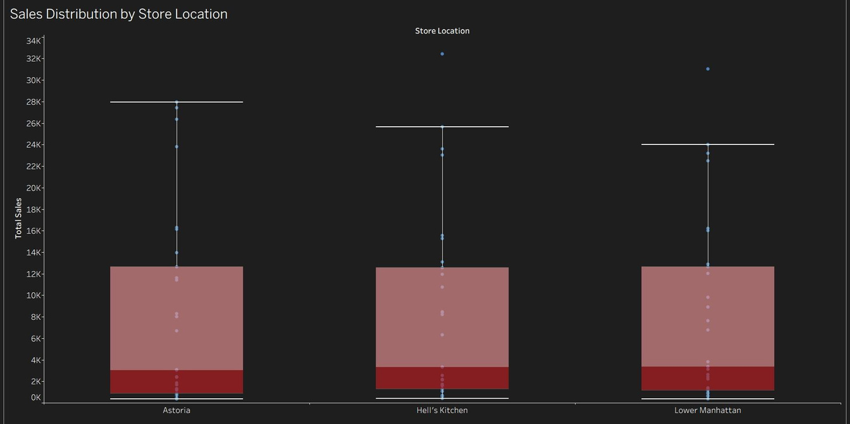
Sales Distribution by Store Location
This analysis visualizes the total sales across key locations: Astoria, Hell's Kitchen, and Lower Manhattan.
It showcases median sales, the full range (minimum to maximum), and highlights any unusual sales outliers.
Notes:
1

Slide 12
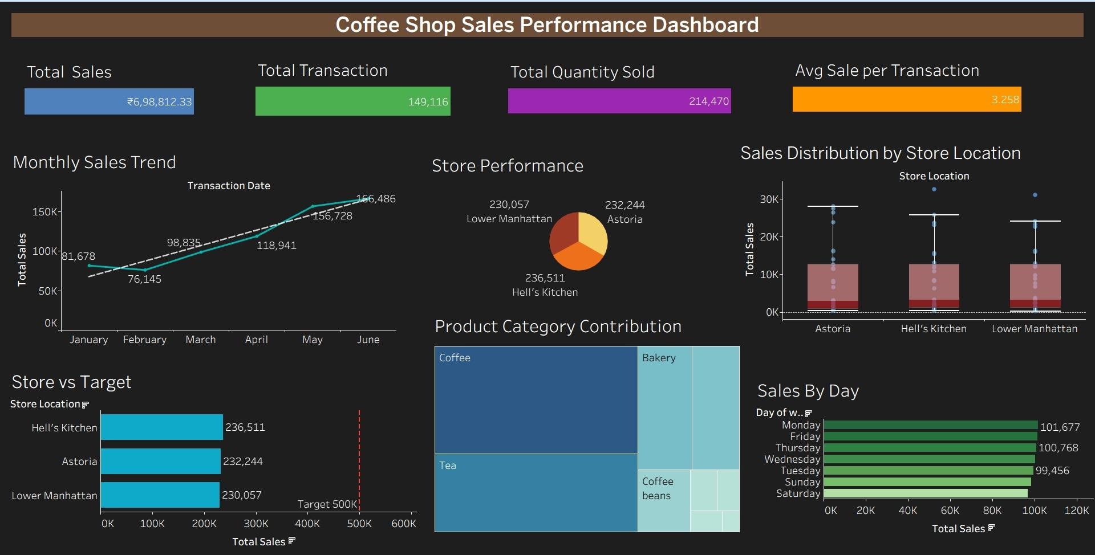
Final Dashboard
Notes:
2

Slide 13

Key Insights from Sales Data
Sales are Consistently Increasing
Month-over-month sales figures show a positive growth trend across all locations.
Hell’s Kitchen: Top Performer
Hell’s Kitchen consistently leads in sales, setting a benchmark for other stores.
Coffee: The Most Popular Category
Coffee products remain the highest-selling category, indicating strong demand.
Mondays Drive Highest Sales
Sales peak on Mondays, suggesting a strong start to the week for customer traffic.
Notes:
3

Slide 14





Strategic Recommendations for Enhanced Performance
Run Weekend Promotions
Implement targeted promotions on weekends to significantly increase customer footfall and boost sales during off-peak days.
Increase Stock of Top Sellers
Ensure optimal stock levels for high-demand items like Coffee & Tea to prevent stockouts and capitalize on popularity.
Replicate Best-Performing Strategies
Analyze and adopt successful strategies from Hell’s Kitchen across other store locations to leverage proven methods.
Set Realistic Monthly Targets
Adjust monthly sales targets to align more realistically with current performance trends while still aiming for growth.
Notes:
4

Slide 15

Thank you
Notes:
5

